Slide 1
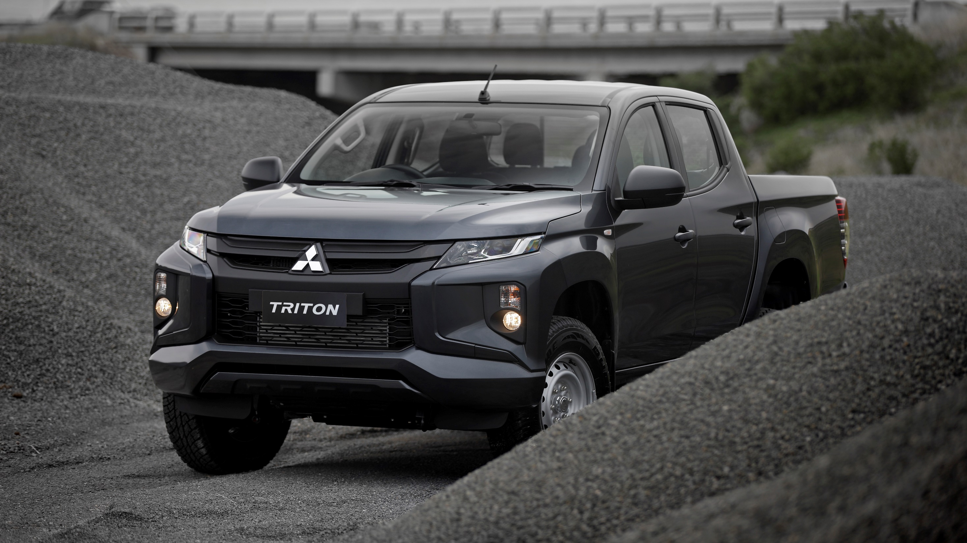


Slide 2
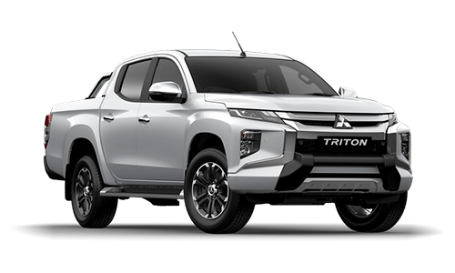
Introducing Mitsubishi Motors Fleet iQ
Mitsubishi Motors Fleet iQ is designed to offer Mitsubishi’s fleet customers an array of services and solutions that enhance mobile resource visibility, safety, and uptime, while reducing total cost of ownership
Mitsubishi Motors Fleet iQ will mean customer vehicles will have the ability to be connected with a fleet management solution before they hit the road
Speed monitoring
Live tracking
Fuel economy report
Trip analysis
Enhanced diagnostics
Harsh braking
Odometer reading
Notes:
Mitsubishi Motors Fleet iQ is designed to offer Mitsubishi's fleet customers an array of services and solutions that enhance mobile resource visibility, safety, and uptime, while reducing total cost of ownership
Mitsubishi Motors Fleet iQ will mean customer vehicles will have the ability to be connected with a fleet management solution before they hit the road
This model will help encourage the adoption of this technology by providing companies with an efficient way to connect their vehicles, while avoiding the associated financial and productivity costs (of) grounding their fleet.

Slide 3

Powered by Fleet Complete
Founded in Canada, Fleet Complete has 20 years of industry knowledge and insight, operating in Australia since 2003 as one of the first adopters to the market
Today, Fleet Complete is one of the fastest growing telematics players globally (Berg Insight 2017-18) with close to 500,000 users spanning over 30,000 businesses in 16 countries
Fleet Complete have developed and support the Fleet iQ platform

Slide 4

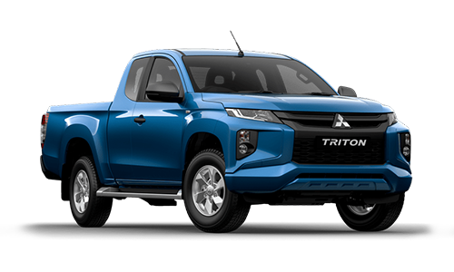


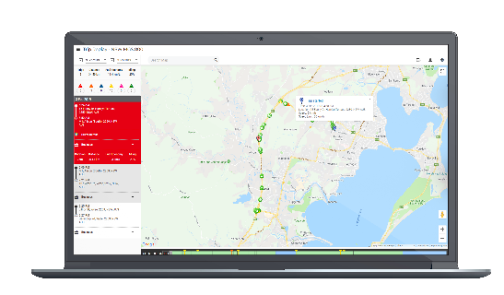
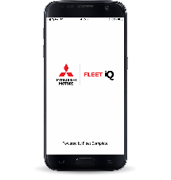
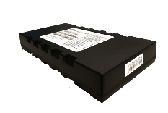
How does the Mitsubishi Motors Fleet iQ platform work?
GPS Satellite
Cell Data Network
Internet
Cell Tower
Mitsubishi Motors Fleet iQ Data Servers
User

Slide 5
Mitsubishi Motors Fleet iQ Solution Overview
Reports vehicle’s real-time location, trip information and past location data
Collects information such as the vehicle’s battery voltage, ignition status, engine data, DTC codes, seatbelt status, etc.
Reports on driver behavior like speeding, long idling, hard braking, hard cornering and rapid acceleration
Sends sensor status and arrival/departure alerts
Provides greater insight into the vehicle’s diagnostic health and its performance in the field
Scalable for businesses with small, medium and large fleets
Mitsubishi Motors Fleet iQ is an in-vehicle GPS modem that connects to the vehicle’s power source through the engine control module and captures mission-critical insight to help managers increase fleet productivity, improve customer service and win more business

Slide 6
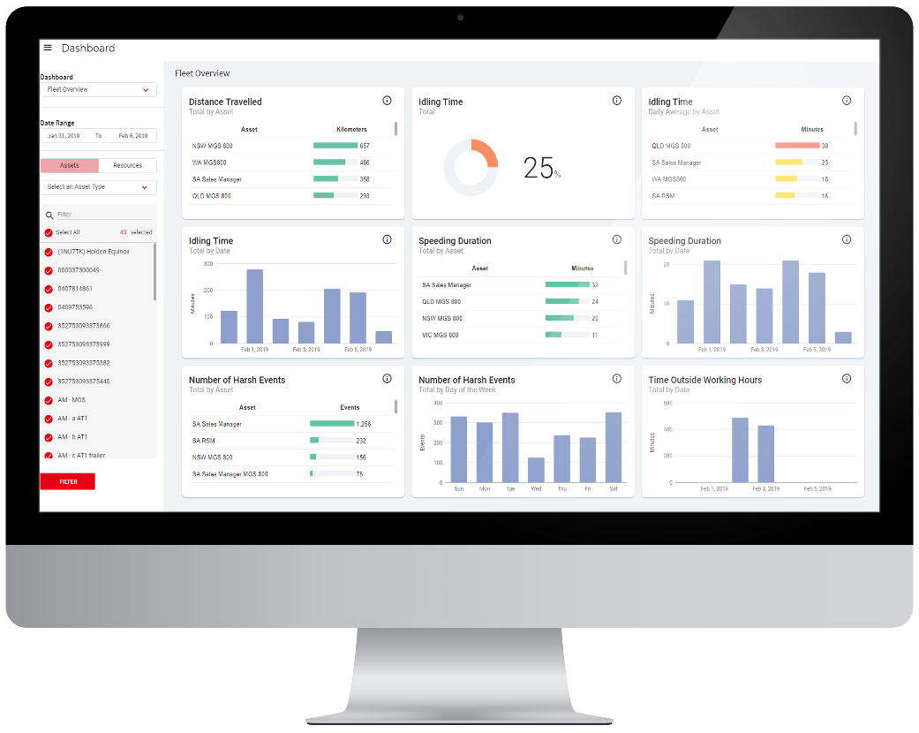
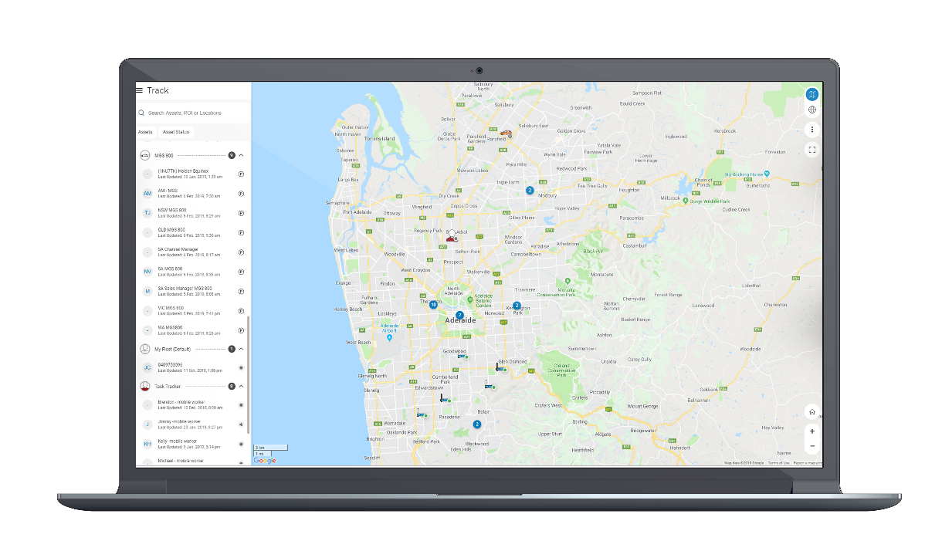
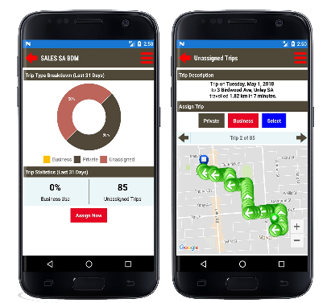
Mitsubishi Motors Fleet iQ Customer Benefits
Increase safety
Improve productivity
Reduce your total cost of ownership
Automate your FBT reporting
Provide better customer service

Slide 7
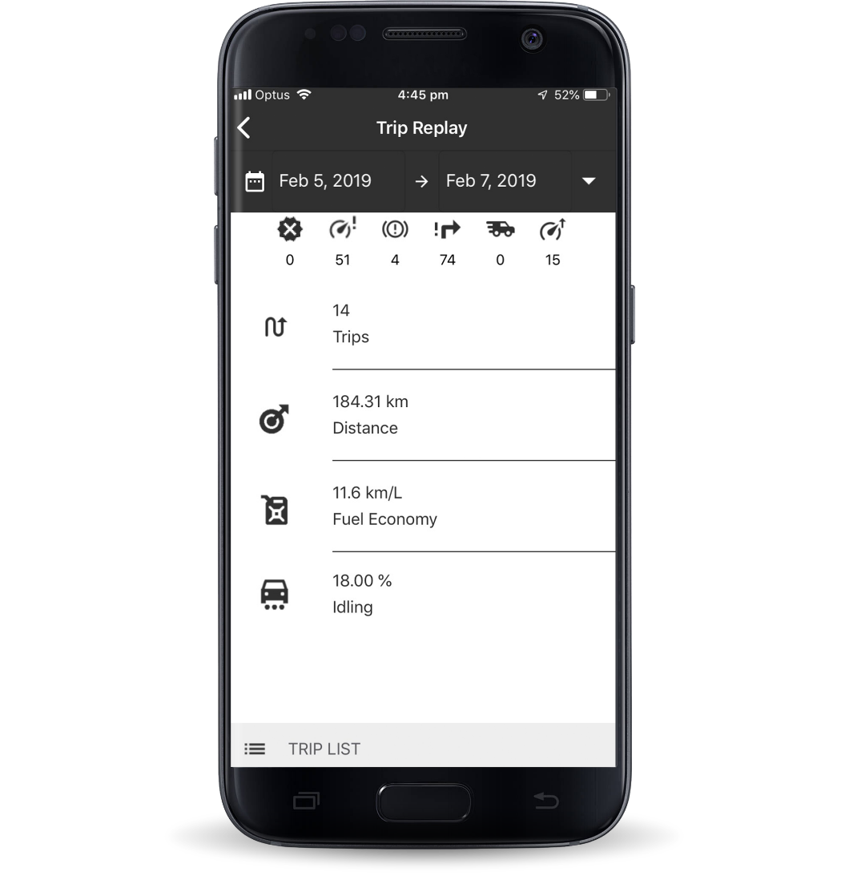



Increase Safety
Driver performance coaching
Accident notifications
Ensure the security of your assets

Slide 8



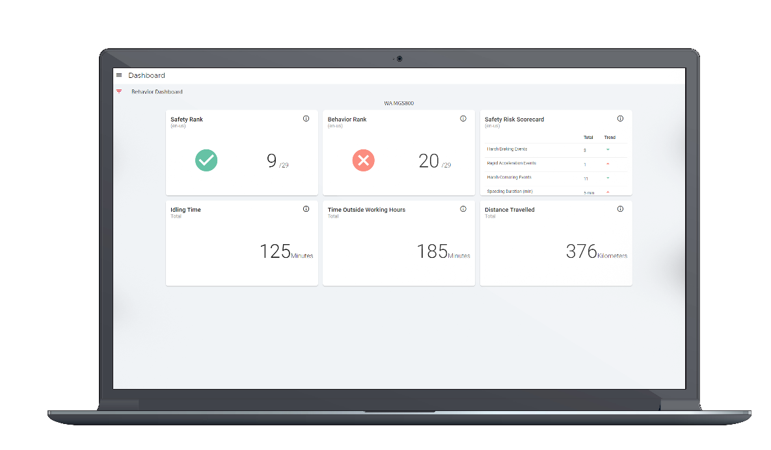
Improve Productivity
Locate your vehicles in an instant
Measure overall performance of your fleet
Identify inefficiencies in your operations

Slide 9

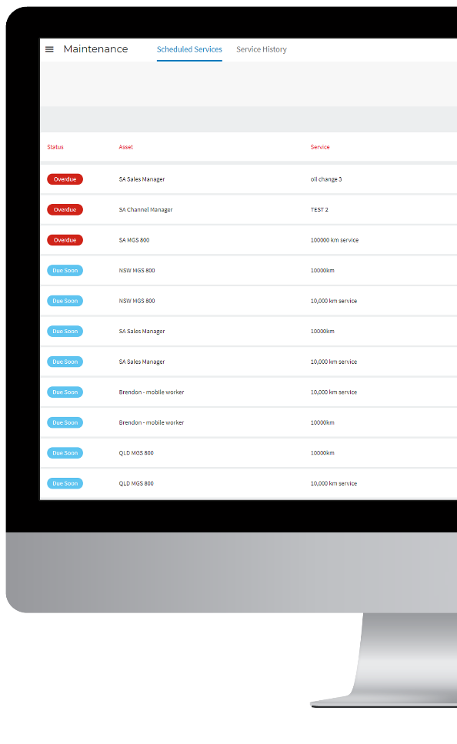




Reduce Your Total Cost of Ownership
Proactively manage maintenance
Detect engine issues fast
Prevent unnecessary vehicle wear & tear
Reduce fuel usage
End-to-end vehicle inspection reporting

Slide 10



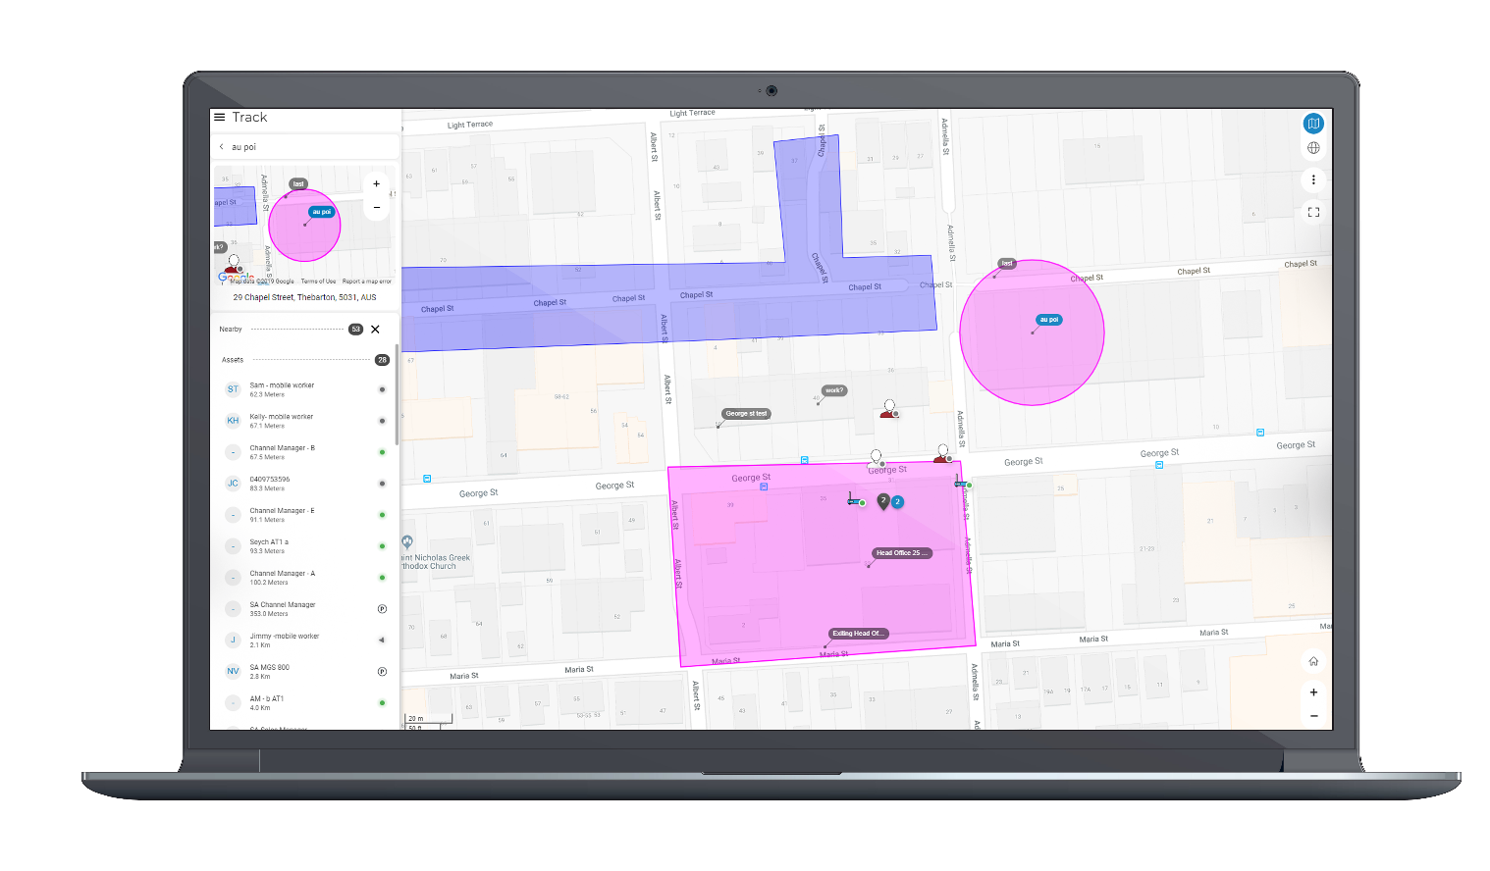
Provide Better Customer Service
Improved dispatch & response times
Proof of service
Provide accurate arrival estimates

Slide 11
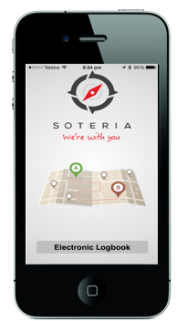
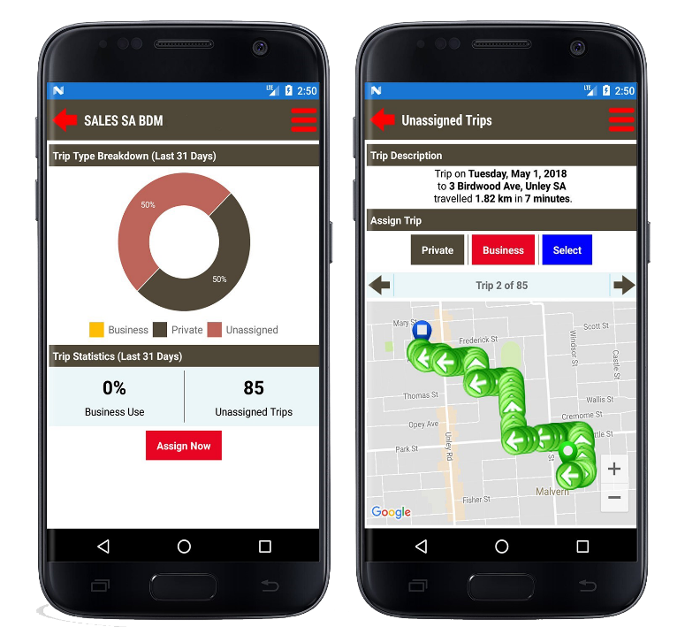
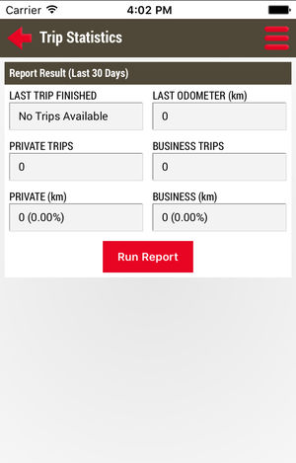
FBT Electronic Logbook
The Logbook solution provides a simple and convenient way to automate time-consuming Business vs Private vehicle logbooks and calculate your maximum Fringe Benefits Tax return.
  A seamless way to separate private and business use of vehicles
  A 100% ATO compliant solution for FBT Reporting with maximum returns
  Ease of use for drivers to provide accurate and easy-to-audit data for reporting
  Benefits of automation for overall administration costs

Slide 12

Log in to Mitsubishi Motors Fleet iQ
Or view our demo video

Slide 13
Thank You

